Slide 1
Multiparametric monitoring of physiological signals through a wearable system.
Project 4:
Components: Berci Cristina, Cozzolino Massimo, Di Flumeri Giorgia, Ferraro Matteo, Gabriele Matteo, Nanni Alex, Paolucci Daniele, Pistillo Federica
Tutor: Sicbaldi Marcello

Slide 2
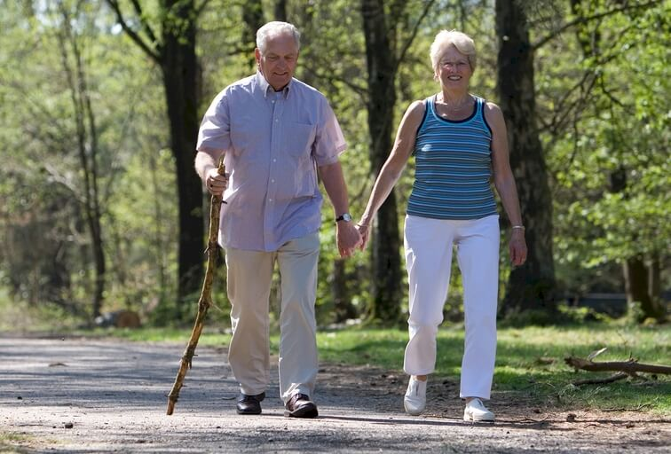
Introduction
The project was born from the need to develop a protocol integrated with an algorithm to evaluate the motor performance and physiological conditions of elderly patients during different tasks through the exploitation of different devices.
Due to the lack of elderly volunteers, we detected signals on coetaneous subjects.

Slide 3
Work's structure
Data acquisition
1 month, in the lab
Data analysis
1 month, teamwork
Code finalization
1 month, subgroups

Slide 4
Objectives
Develop a protocol to acquire data from physical activities;
Perform different motor tasks with multiple subjects;
Analyze and optimize signals detected;
Exploit Machine Learning for automatic task's recognition (Python);
ECG and PPG features analysis in respect to different tasks;
Acknowledgement and removal of artefacts (MatLab);

Slide 5
Work subdivision
Subgroup 1
Subgroup 2
Task division (based on IMU data);
Machine Learning (Python);
Parameters comparison;
Sensor fusion.
Data acquisition;
ECG, PPG analysis;
Berci Cristina Ioana;
Cozzolino Massimo;
Gabriele Matteo;
Nanni Alex.
Di Flumeri Giorgia;
Ferraro Matteo;
Paolucci Daniele;
Pistillo Federica.

Slide 6

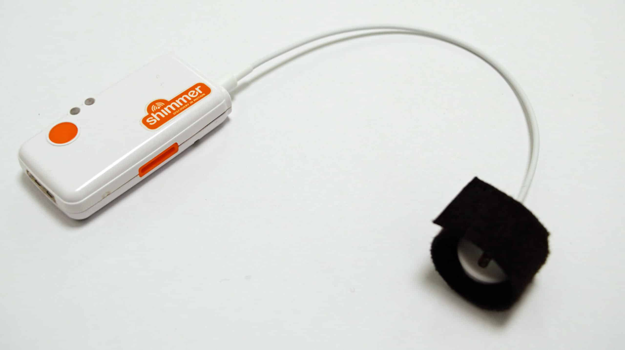
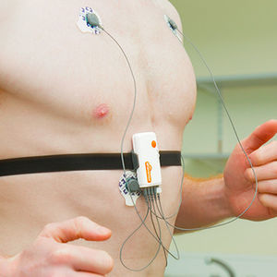
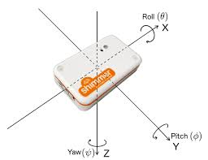
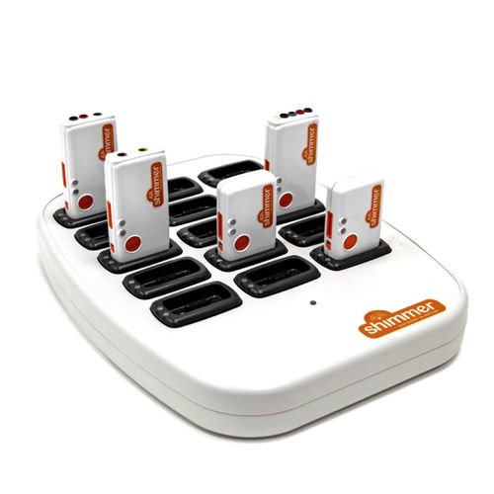

Data Acquisition
Sensors:
ECG
IMU
PPG
Software:
ConsensysPro, Basic version

Slide 7
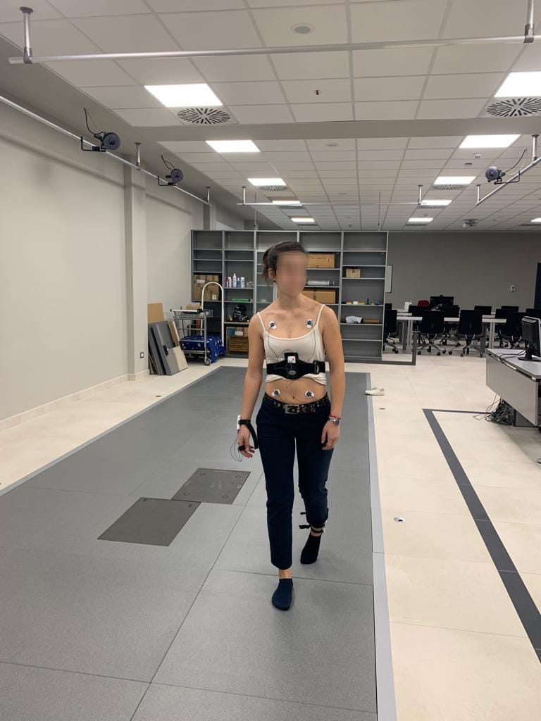
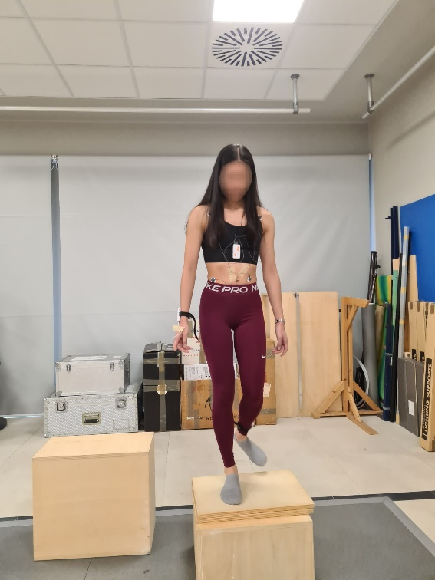
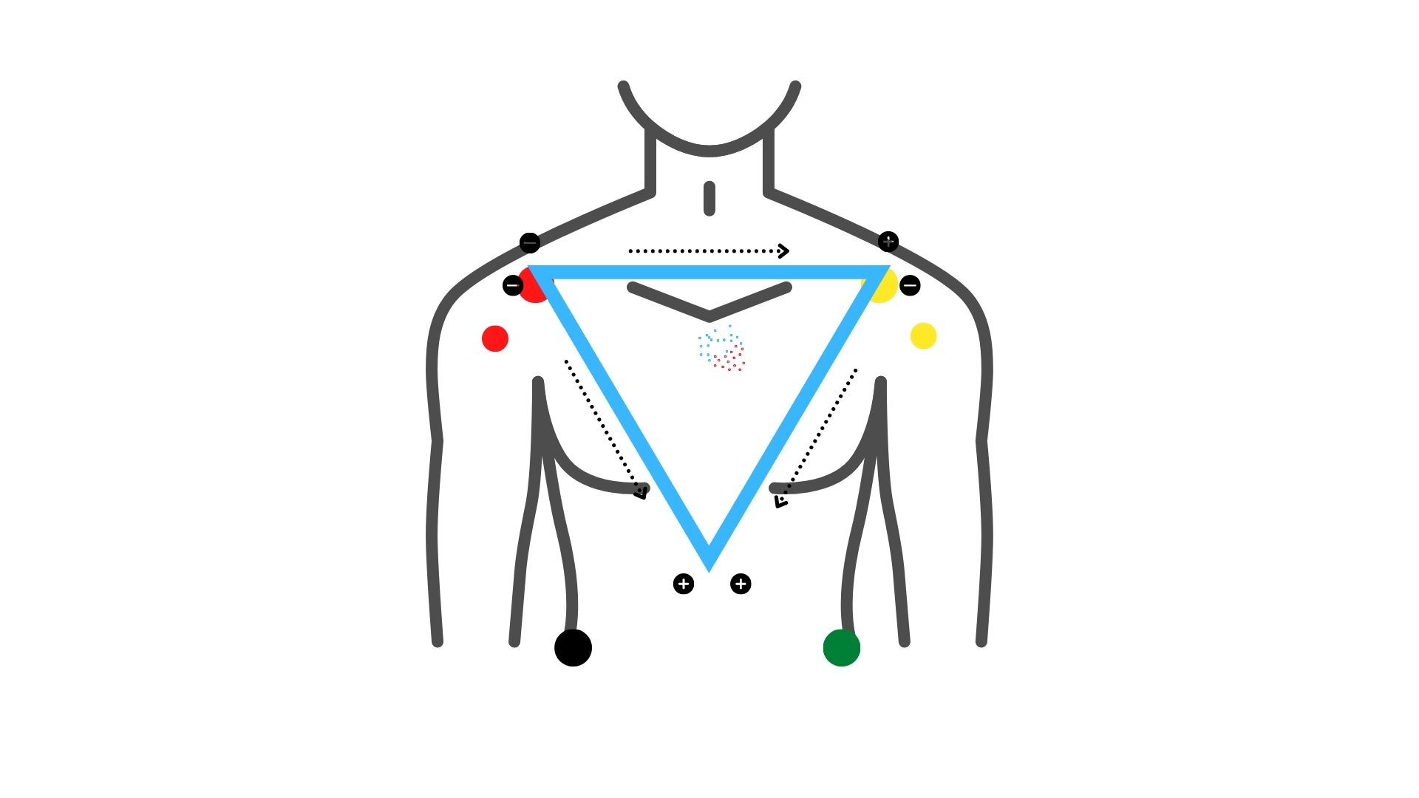
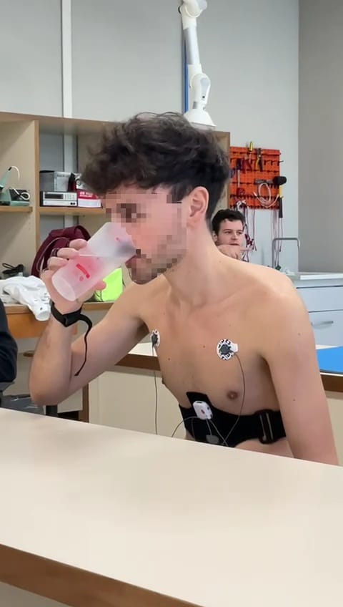
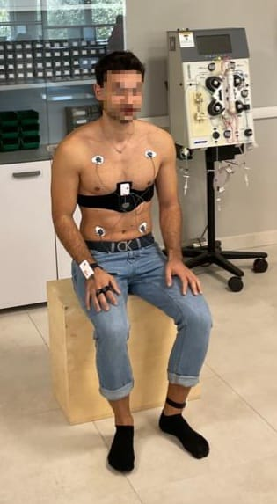
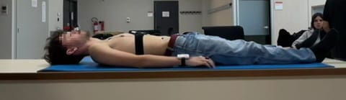
Sensor Positioning
PPG: on the right index finger;
IMU: on the left ankle;
ECG: on the trunk, with the four derivations (RA, LA, RL, LL);
All 3 systems include an accelerometer and a gyroscope

Slide 8
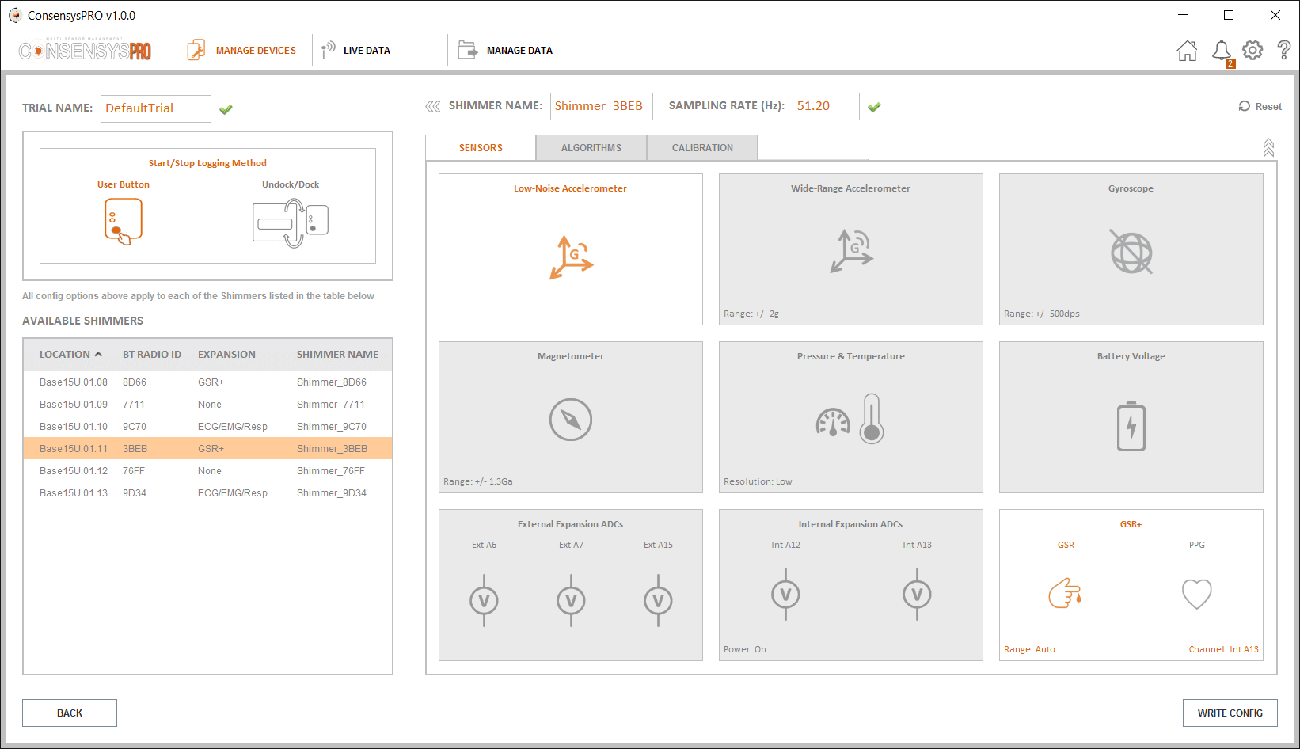
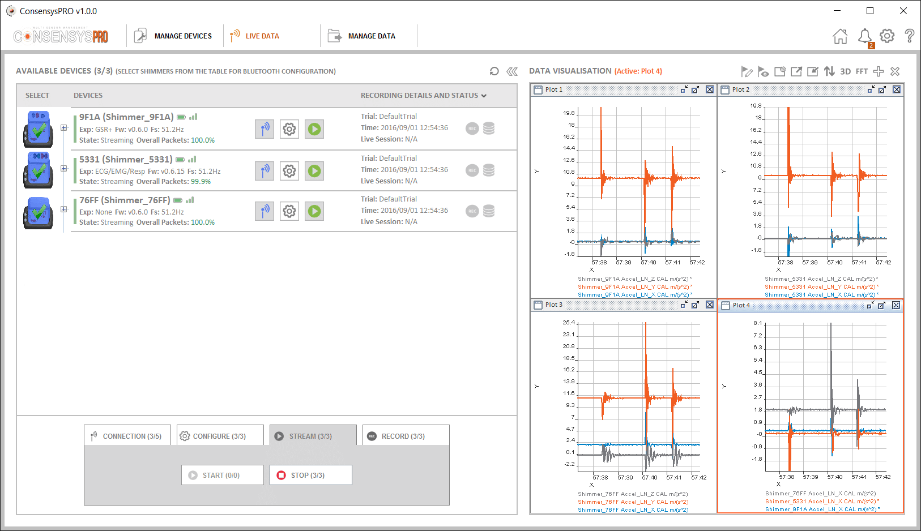
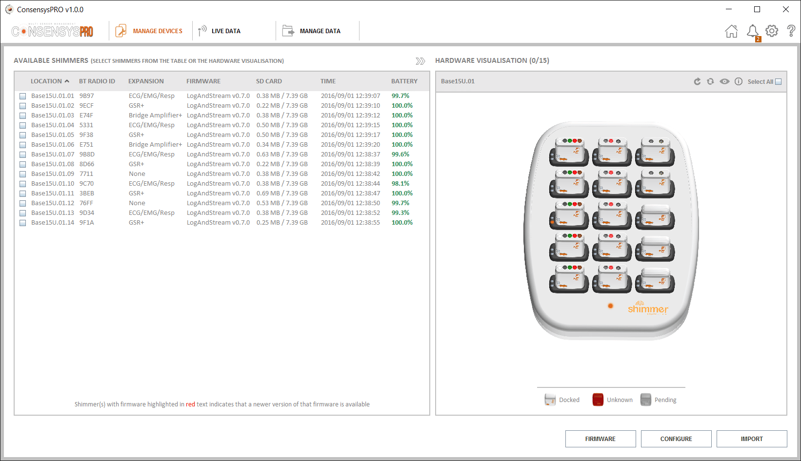
ConsensysPRO Software
Consensys is the software that works alongside Shimmer sensors which adds significant features to live data, managed data and devices. It is designed for adaptive human data collection in the field, large scale repeatable trials and general multi-sensor management.
Real time visualization, only in the Pro Version, not included in the Basic package.

Slide 9
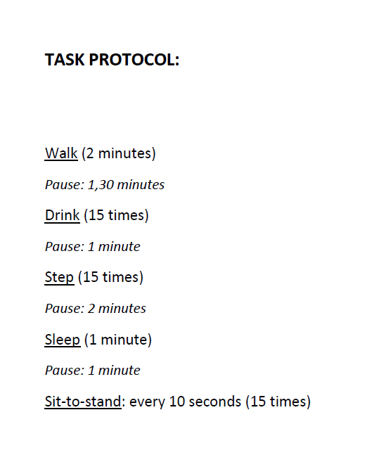
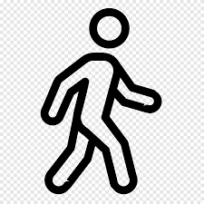

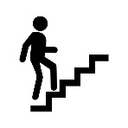
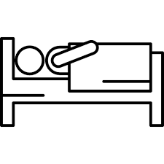


Tasks' Description
Walking
Drinking
Step
Sleeping
Sit-to-Stand
Laboratory Protocol
A sudden, predefined movement (ankle lift, hand bump on thorax) is performed at the beginning/end of each task.

Slide 10
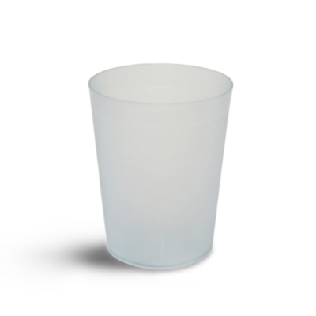
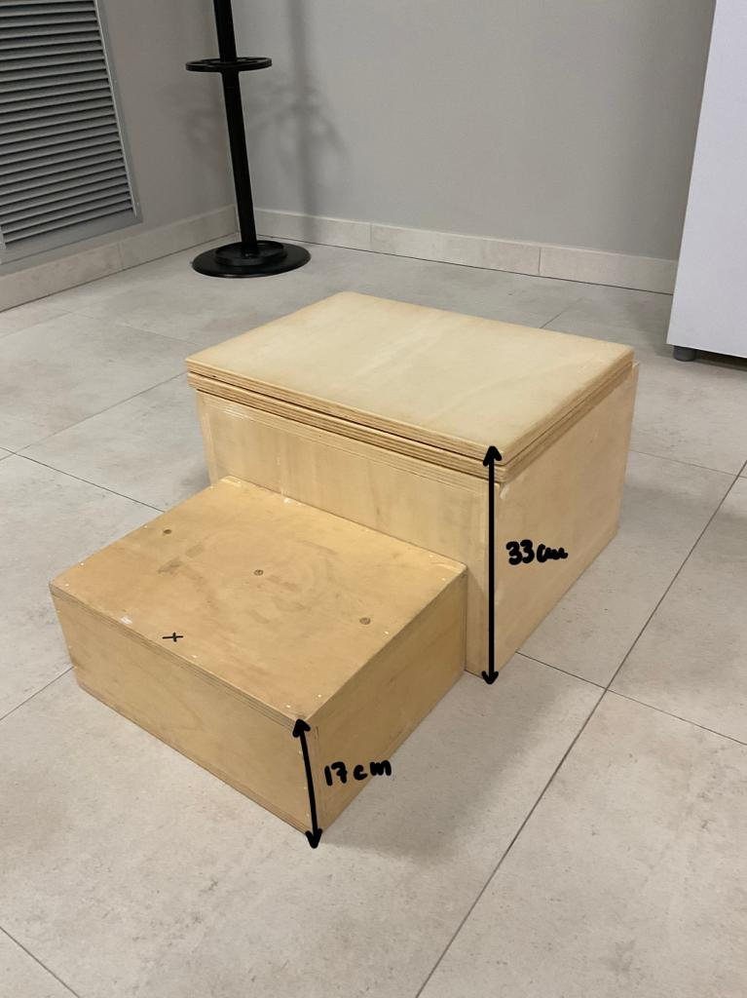
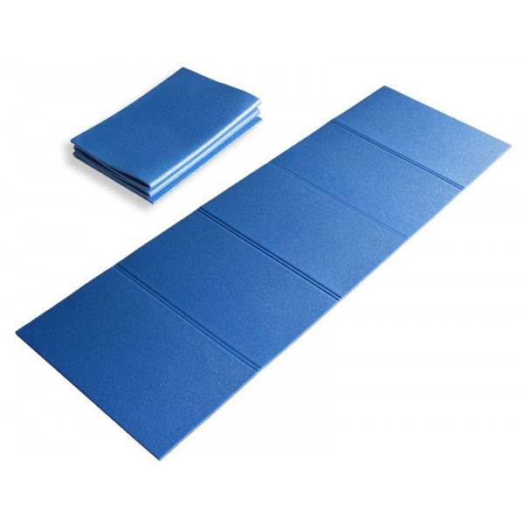
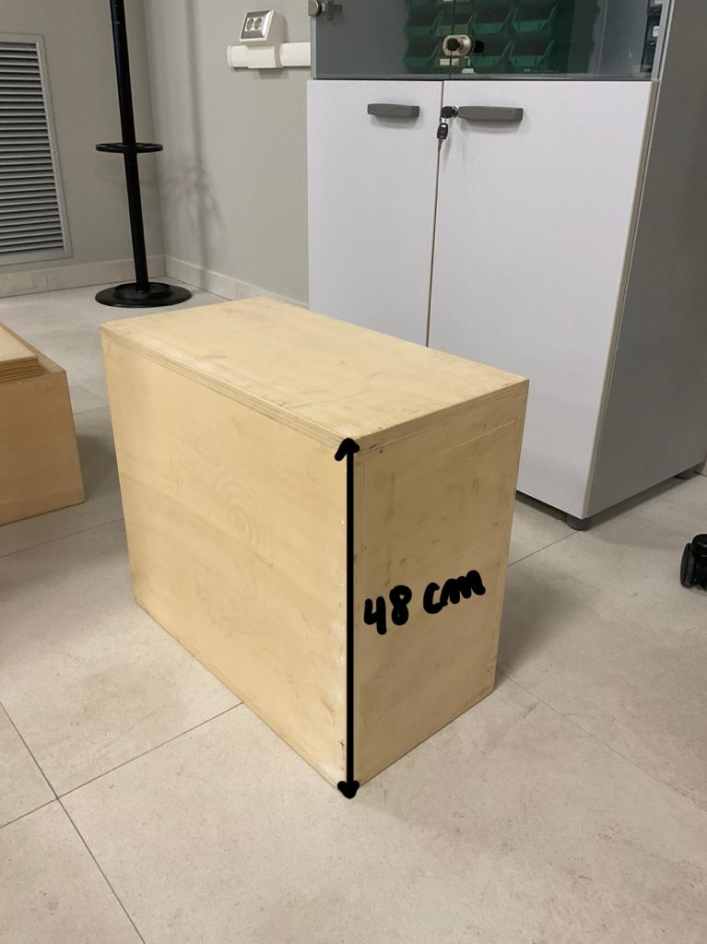
Tools Description
Walking: 10 meters round trip;
Drinking: Plastic water glass;
Step : 17 and 33 cm high wooden blocks;
Sleeping: Mat;
Sit-to stand: 48 cm high wooden block.

Slide 11

Path Errors
ECG data problems due to electrodes placement;
Strap misplacement and multiple variables;
Noise in electrodes analysis due to body's hair Shaving;
Lab Computer without Bluetooth connection;
Synchronization problems for sensor startup;
Real time data analysis problems.

Slide 12
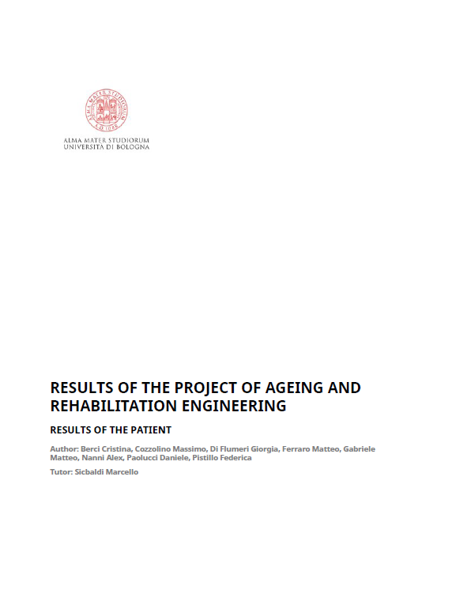
Matlab Report generator
Matlab report Generator creates automatically a file with all the plots and most relevant data of the patient, in order to help the work of the operator.
The objective of this report is to summarize in graphic terms the results of the Heart rate variability for the two signals, the Correlation Coefficient between different tasks and the frequency analysis of both the ECG and the PPG.

Slide 13

Preprocessing
Synchronization of data;
Identification of the peaks related to the execution of the predetermined movement. Focus on acceleration data of the IMU sensor (left ankle): most prominent peaks;
Subdivision of the tasks;
Analysis of acceleration trends for each subject;
Software: Matlab

Slide 14
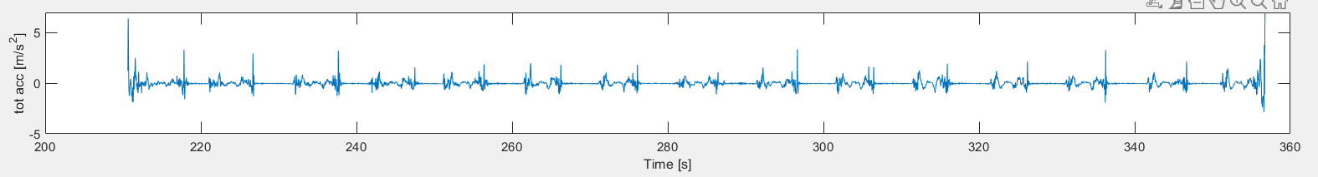
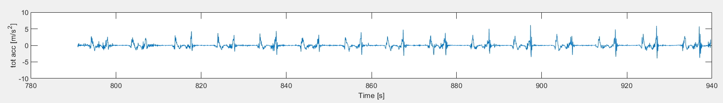
Processing for Classification
Only for acceleration and angular velocity: Data filtering - BandPass Filter;
Identification of different repetitions in discrete tasks (drinking, sit-to-stand);
Subj 2 – Drinking – SMV wrist
Subj 9 – Sit-to-stand – SMV chest

Slide 15
Features Extraction - Classification
Signal of interest: SMV (Signal Magnitude Vector)
8-seconds windows for features extraction
Features:
Mean and standard deviation;
Dominant frequency and its power;
Second dominant frequency and its power --> Only for the wrist-worn sensor;
Total power (in the range [0.3 - 15 Hz] );
Dominant frequency and its power in the range [0.6 - 2.5 Hz];
Ratio p1/total_power;
Suitable for protocol
Optimal for FFT
Reference: ZHANG, S., A. V. ROWLANDS, P. MURRAY, and T. L. HURST. Physical Activity Classification Using the GENEA Wrist-Worn Accelerometer. Med. Sci. Sports Exerc., Vol. 44, No. 4, pp. 742–748, 2012

Slide 16

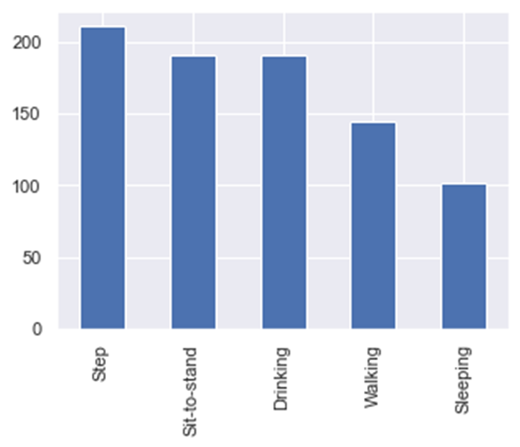
Classification
Methods: traditional classification vs LOSO;
6 algorithms:
-Decision tree;
-Linear Discriminant Analysis;
-Kneighbors;
-GaussianNB;
-SVC;
-Random Forest;
Accuracy analysis and feature selection;

Slide 17

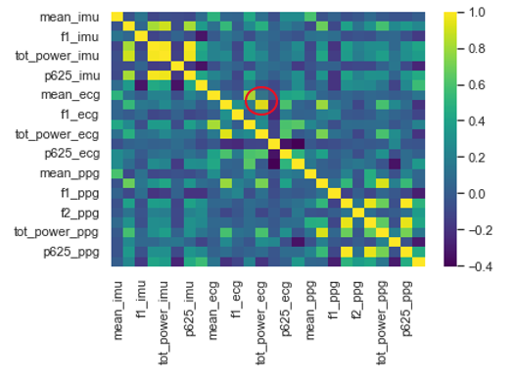
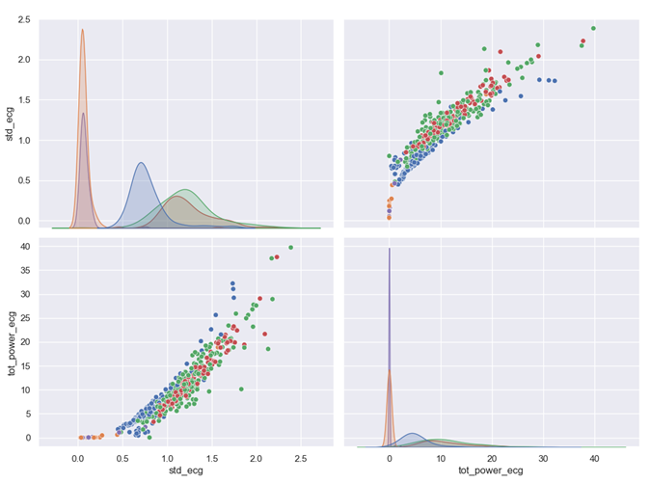
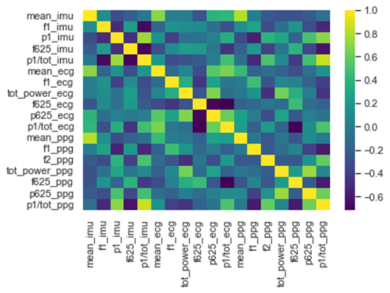
Feature Selection
Example of two highly correlated features
Correlation matrix cleaned
Feature correlation matrix

Slide 18
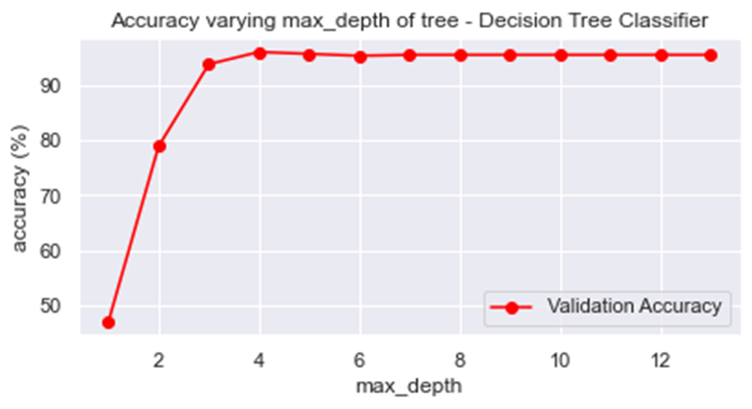
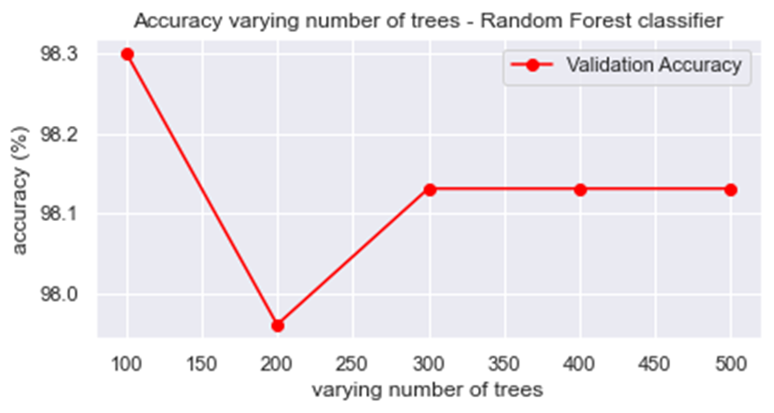
Accuracy and hyperparameters' choice
Accuracy of 98.3% with number of trees = 100
Random Forest Classifier
Decision Tree Classifier
Accuracy of 96.6% with max_depth = 4

Slide 19
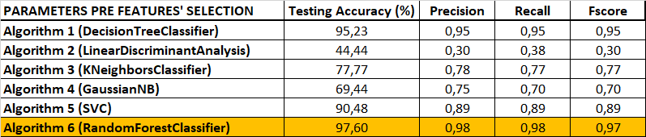
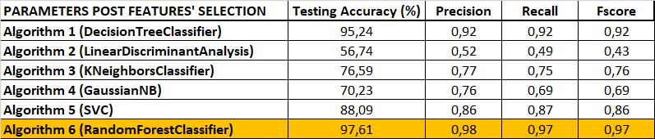
Algorithms comparison

Slide 20
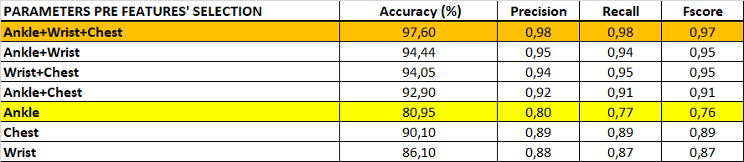
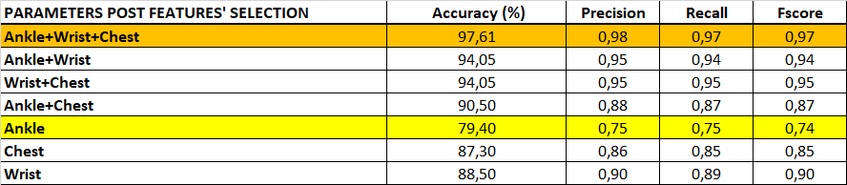
Sensor combination comparison with Random Forest classifier

Slide 21
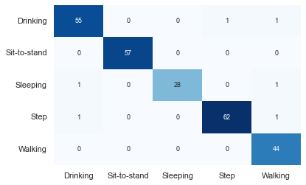
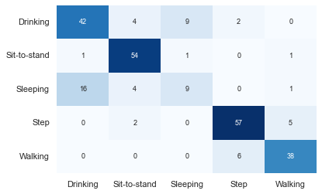
Confusion matrices: Random Forest Classifier
Confusion matrix obtained from all sensors together
Confusion matrix obtained only from ankle's sensor

Slide 22
Classification LOSO
LOSO (Leave-One-Subject-Out) cross-validation
Traditional classification
LOSO
Trained on N-1 subjects
Tested on the left-out subject
Preferable method
Less affected by data inter-subject variability
Trained on 70%
Tested on 30%
Data overfitting
→ Positive results inflation

Slide 23
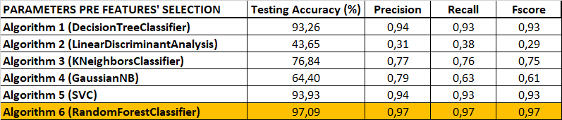

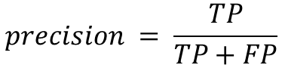
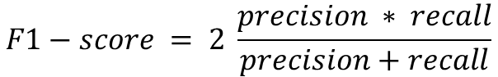
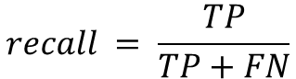
Algorithms comparison (LOSO)
$$F1−score = 2 \frac{precision ∗ recall}{precision+recall}$$
$$precision = \frac{TP}{TP+FP}$$
$$recall = \frac{TP}{TP+FN}$$

Slide 24
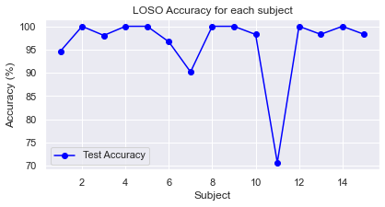
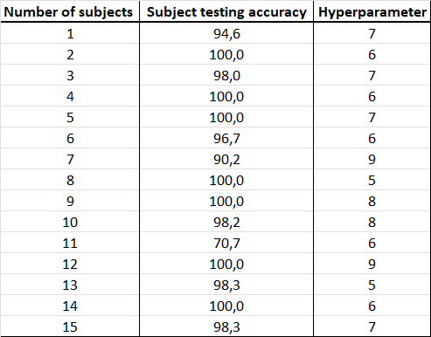
Accuracy Algorithm Random Forest (LOSO)

Slide 25
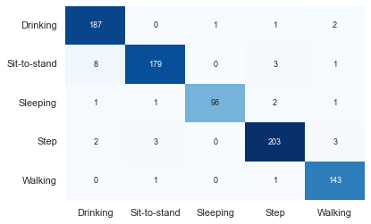
Confusion matrix algorithm Random Forest (LOSO)
Cumulative confusion matrix obtained by summing the confusion matrices of all subjects

Slide 26
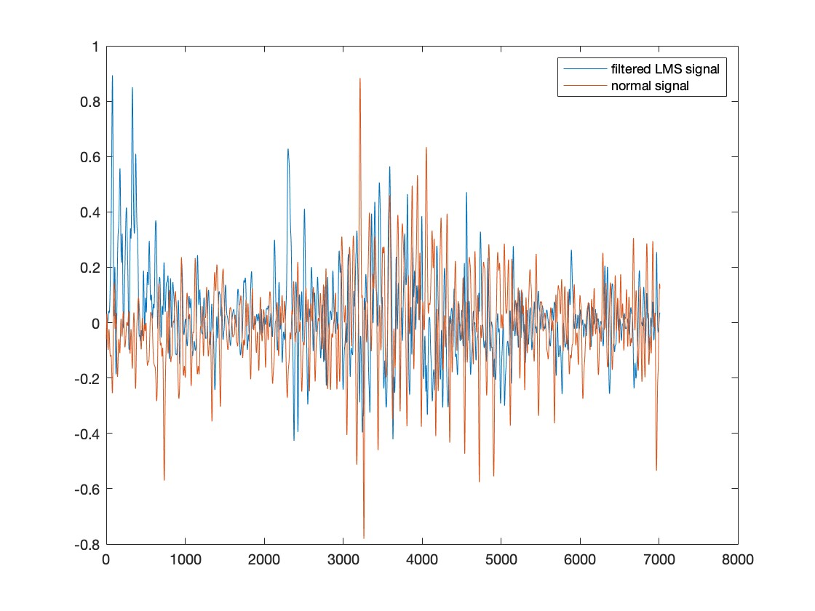
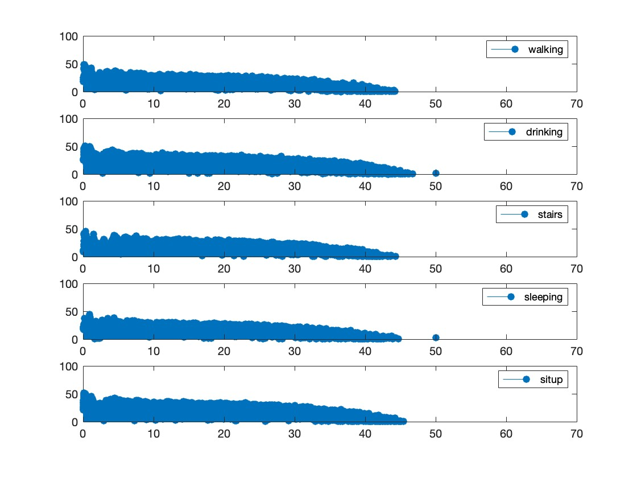
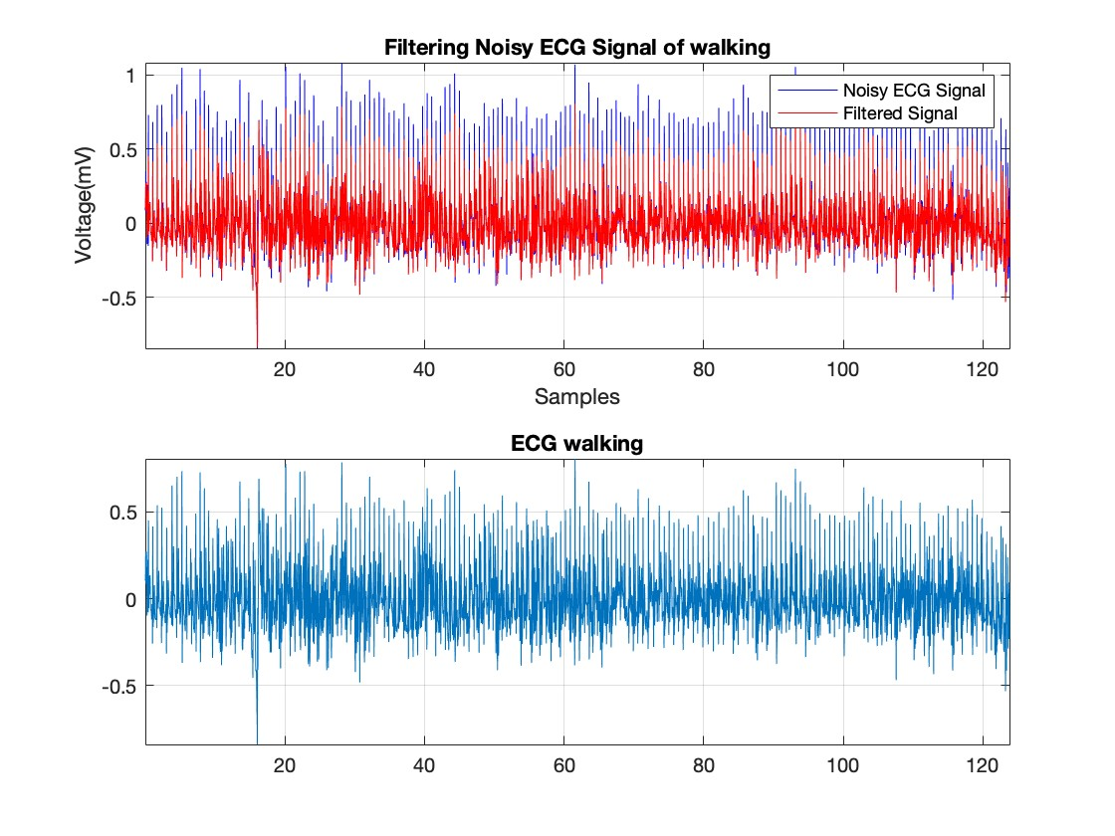
Artefacts
ECG
PPG

Slide 27
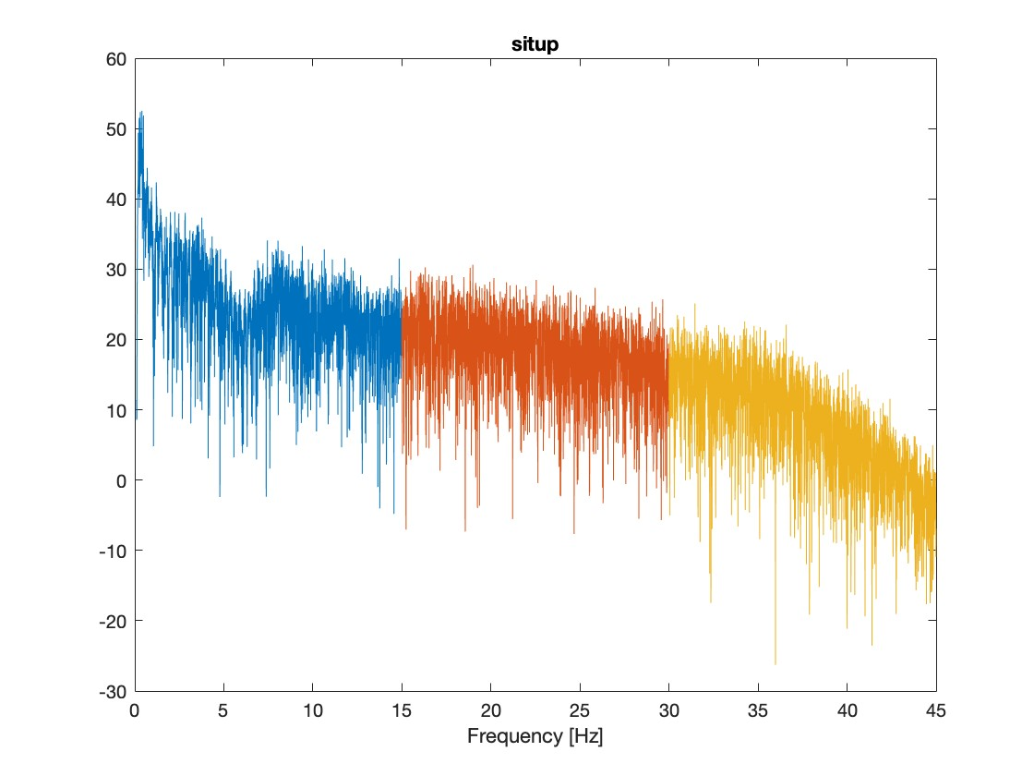
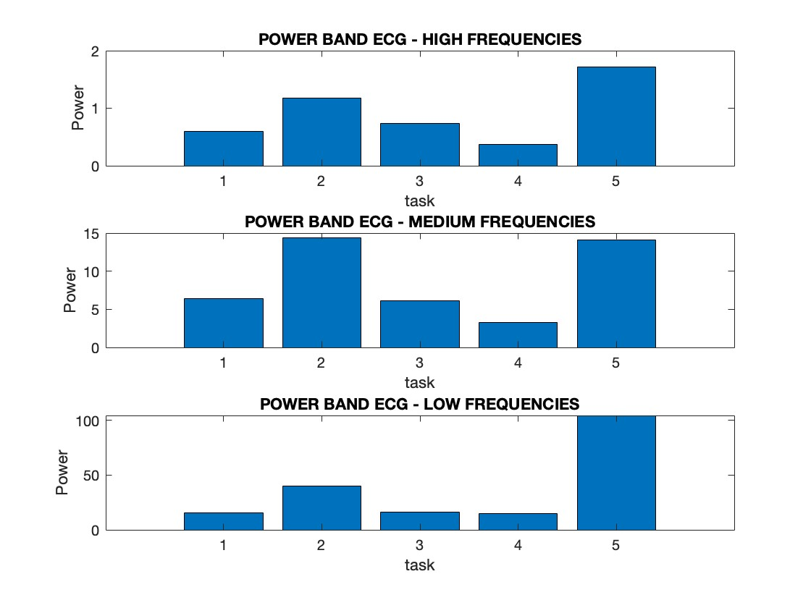
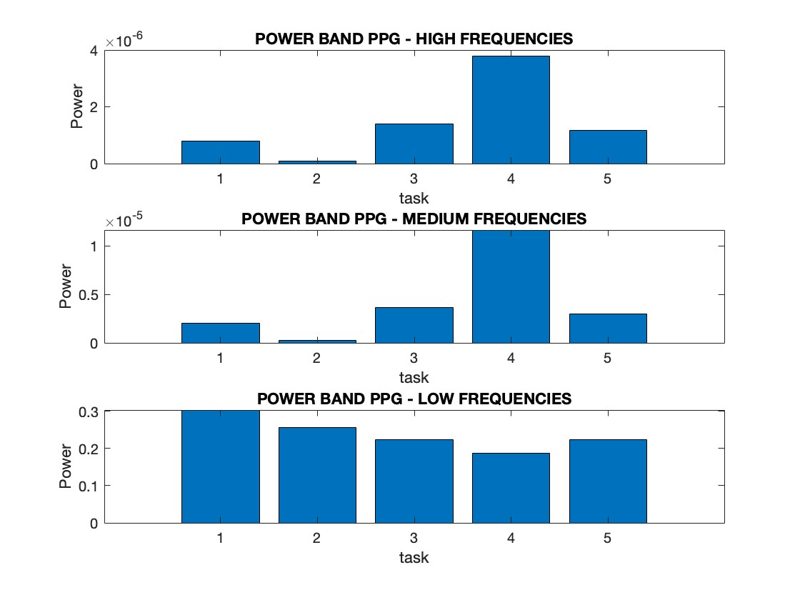
ECG and PPG frequencies and power

Slide 28






Heart rate variability ECG

Slide 29






Heart rate variability PPG

Slide 30


Correlation coefficient ECG

Slide 31


Correlation coefficient PPG

Slide 32





Scalogram

Slide 33


Adaptive window
Identification of Characteristic Points in Multivariate Physiological Signals by Sensor Fusion and Multi-Task Deep Networks (2022)
Matteo Rossi Giulia Alessandrelli Andra Dombrovschi Dario Bovio Caterina Salito Luca Mainardi Pietro Cerveri

Slide 34


Neural Network
Worsening
Improvement
Automatic ECG Classification Using Continuous Wavelet Transform and Convolutional Neural Network(2021)
Tao Wang Changhua Lu Yining Sun Mei Yang Chun Liu Chunsheng Ou

Slide 35

Artefact reduction

Slide 36

There ain't no such thing as a free meal...

Slide 37
Conclusions
The project focused on evaluating data recorded by different sensors through a Machine Learning system to classify the tasks and analyze the physiological conditions of different subjects with Matlab.
Machine Learning: best Algorithm "Random Forest Classifier" (pre/post features' removal);
Heart Rate Variability from ECG and PPG signals;
Best filters to reduce artefacts:
ECG Savitzky-Golay and Butterworth filter;
PPG Butterworth filter;
Sensor fusion: better signals' quality thanks to neural networks (ML algorithm NERX) and features' report.

Slide 38
Future Developments
Exploit better instrumentation (HW,SW);
Find better tuning parameter for Neural Network;
Evaluation in daily life;
Stricter task protocol;
Real time analysis;
Explore different ML classification algorithms;
Apply the project on elderly patients.

Slide 39
References
Activity Recognition from Accelerometer Data – Nishkam Ravi et. al.
Activity recognition using a single accelerometer placed at the wrist or ankle – Andrea Mannini et. al.
Artefact detection and quality assessment of ambulatory ECG signals – Jonathan Moeyersons et. al.
Detection and Removal of Motion Artifacts in PPG Signals – David Pollreisz et. al.
Estimation of Heart Rate Variability from Finger Photoplethysmography During Rest, Mild Exercise and Mild Mental Stress – Bjørn-Jostein Singstad et. al.

Slide 40
Thanks for your attention
Project realized by:
Berci Cristina
Cozzolino Massimo
Di Flumeri Giorgia
Ferraro Matteo
Gabriele Matteo
Nanni Alex
Paolucci Daniele
Pistillo Federica

